Slide 1
How to make them work
Smart Card Middleware Drivers
(the bit that allows the card to be read from / written to!)
Supplied by 3rd party vendors
Government Standards may not require extra drivers (e.g PIV)
Centrify and Thursby products have support for these by default
US PIV standard is supported directly by macOS Sierra

Slide 2
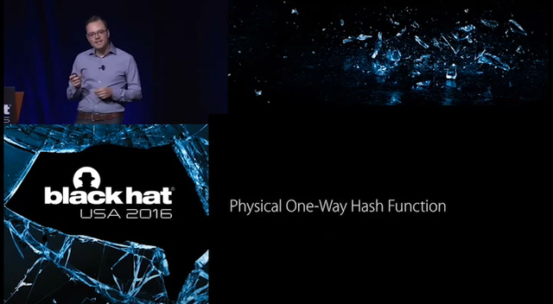
Apple Security Primer
Let’s hear from Ivan what they do next …
Notes:
Ok Tom doesn’t really work for Apple.

Slide 3
How to make them work
USB Card Reader - Omnikey 3121

Slide 4
How to make them work
USB Card Reader – Identive Cloud 2900R

Slide 5
How to make them work
USB Card Reader – Identive SCR3500

Slide 6
How to make them work
USB Card Reader – Identive SCR3500A

Slide 7
How to make them work
(optional) Smart Card USB Driver
Apple’s provided CCID drivers work in a lot of cases
The Omnikey 3121 driver is pretty good, but shouldn’t be needed.
Identive: Contender for “Worst macOS package ever made”
Probably won’t work with 10.12 due to SIP!
So horrifying I removed the slide showing the “bad things”

Slide 8
How to make them work
macOS Configuration – Authorization Database
You need to enable support for cards at the loginwindow
And also for the screensaver
security authorizationdb smartcard enable

Slide 9
How to make them work
macOS Configuration – Configuration Profile
PayloadType:
Key:
Type: Integer
Setting:
Currently doesn’t work in 10.12!
Bug report filed. https://openradar.appspot.com/radar?id=4950591520374784
com.apple.screensaver
tokenRemovalAction
Integer
“1” or “0”
Notes:
This ONLY works after you have configured your account for authentication with a Smart Card.
Bug in 10.11 and 12 that causes these settings to reset themselves. defaults write commands ineffective.
Another bug in 10.12 that causes tokenRemovalAction to not work at all

Slide 10
How to make them work
macOS Configuration – Configuration Profile (10.12 CTK drivers)
PayloadType:
Type:
Key:
Enables/Disables the card pairing dialog, although existing pairings will still work.
Key:
Enables/Disables the card for login, authorisations and screensaver unlocking.
Key:
Enables/Disables certificate pinning for the card certificates.
Key:
Restricts a user to a single smart card. Doesn’t affect current cards parings.
com.apple.smartcard
Boolean
UserPairing
allowSmartCard
checkCertificateTrust
OneCardPerUser
Notes:
Why is “checkCertificateTrust” set to disabled by default? Should be enabled!

Slide 11
How to make them work
And as if by magic (using legacy drivers)
Your smart card should appear as a secondary keychain on the system

Slide 12
How to make them work
And as if by black magic (from 10.12 onwards using CTK API)
On macOS Sierra using new API, card certs form part of user keychain!
Also, they are not accessible from Keychain Access!
All the smartcard info has been moved to the security command.
security

Slide 13
How to make them work
security command options (from 10.12 onwards using CTK API)
list-smartcards
Displays information on all available smartcards
export-smartcard
Exports information from a specified smartcard
smartcards
Enables, Disables or Lists smartcard tokens
Requires working CryptoTokenKit API drivers!
list-smartcards
export-smartcard
smartcards

Slide 14
Authentication Methods
The local account methods
Hash Matching with the legacy methodology
Fixed Key Mapping with the new CTK API
Use the OS supplied script “sc_auth”
Then there’s Attribute Matching with both methods (!)
I will glance over Attribute Matching until later

Slide 15
Authentication Methods
Hash Matching – sc_auth command (all OS versions)
(run as root!)
sc_auth hash
Lists the hashes of all certificates visible to the OS
sc_auth accept –u *username* -h *hash*
Adds the hash of the cert to the local user account
sc_auth list –u *user*
Shows any certificate hashes for a given username
sc_auth hash
sc_auth accept –u *username* -h *hash*
sc_auth list –u *username*
Notes:
WARNING: This command changes it’s parameters between OS versions!

Slide 16
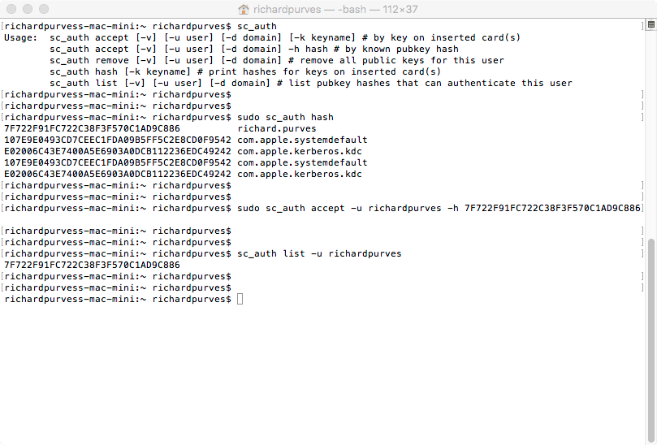
Authentication Methods
Hash Matching – sc_auth command

Slide 17
Authentication Methods
Fixed Key Mapping – sc_auth command
(run as root!)
sc_auth hash
Associates a user with a public key on a card.
S
List all identities on all smart cards
sc_auth list
List all public keys associated with a user.
sc_auth pair
sc_auth identities
sc_auth list
Notes:
Old commands still present but marked as Legacy.
Massively reworked for CryptoTokenKit API

Slide 18
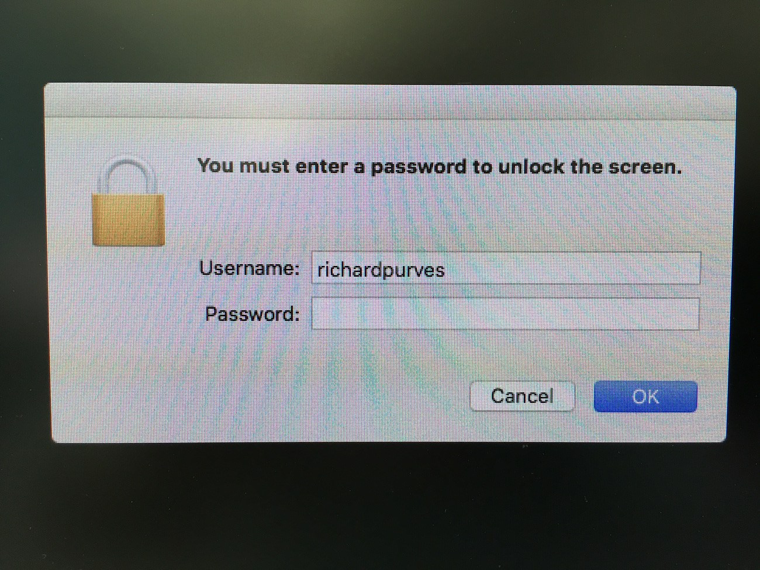
Authentication Methods
Local Account Login
Notes:
I’m going to miss out Attribute Matching deliberately. We’ll mention it later.

Slide 19
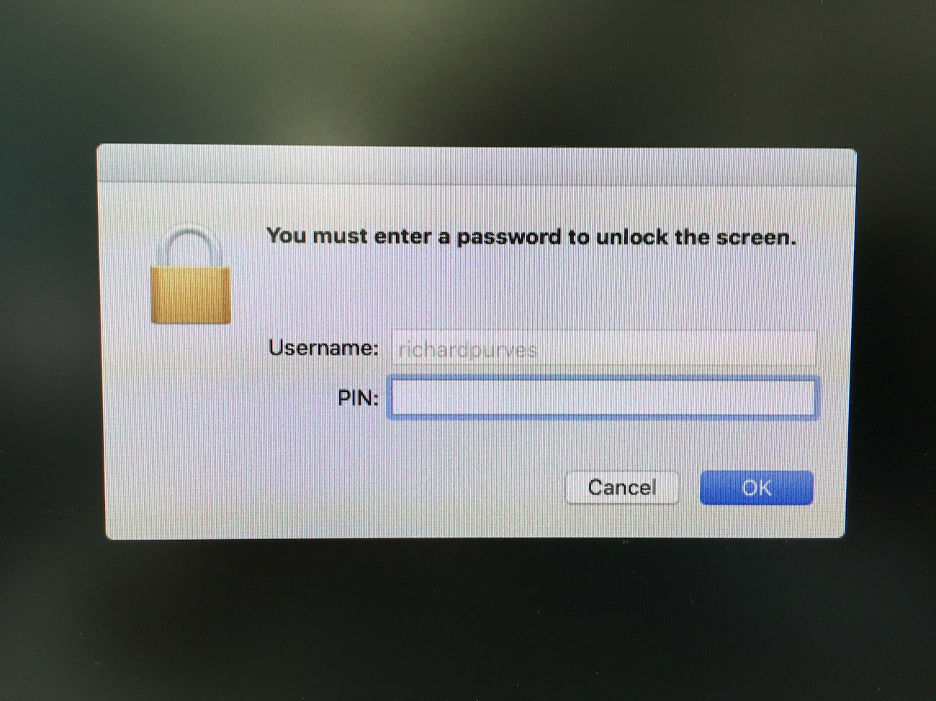
Authentication Methods
Local Account w/ Smartcard Login

Slide 20
Authentication Methods
Local Account – Issues
Smartcard PIN MUST MATCH local account password!
Immediate keychain errors as the PIN fails to unlock the “login” keychain
(Sierra unclear with new API)
Requires a ROOT CA Certificate to validate the card certificate!
Any card belonging to any user can be “attached” to any local account
What happens when the certificate on the card is revoked or expires?
Local account password still works

Slide 21

Authentication Methods
SSH – The incomplete implementation for Sierra
All valid certs from smartcards are provided to the “ssh-keychain.dylib” library
Card Access is controlled by two methods:
Environment Variable

Slide 22
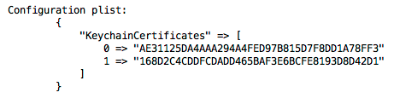
Authentication Methods
SSH – The incomplete implementation for Sierra
All valid certs from smartcards are provided to the “ssh-keychain.dylib” library
Card Access is controlled by two methods:
Per user configuration plist
~/.ssh/sshkeychain.plist
~/.ssh/sshkeychain.plist

Slide 23
Authentication Methods
SSH – The incomplete implementation for Sierra
All valid certs from smartcards are provided to the “ssh-keychain.dylib” library
man ssh-keychain
Hopefully we’ll get something more robust in future macOS versions
man ssh-keychain

Slide 24
Authentication Methods
PKINIT (or how I learned to re-love Active Directory)
First appeared in OS X 10.6.3
Active Directory with properly implemented Kerberos
Certificate Authority service
ROOT CA certificate installed on clients
Uses the same configuration as Attribute Mapping
… and some optional things, maybe.
Notes:
Learning to re-love AD is like trying to forgive someone for infidelity.
Open Directory doesn’t work here!

Slide 25
Authentication Methods
PKINIT (or how I learned to re-love Active Directory)
These are true mobile accounts, not local.

Slide 26


Authentication Methods
PKINIT – The (simplified) Process
User account is provisioned with an individual certificate from the CA.
1

Slide 27
Authentication Methods
PKINIT – The (simplified) Process
User unlocks the cert on the smart card, allowing the OS to use it.
2

Slide 28
Authentication Methods
PKINIT – The (simplified) Process
OS sends a TGT Request to the Active Directory DC(s) using certificate from the smart card
3

Slide 29
Authentication Methods
PKINIT – The (simplified) Process
DC checks the supplied cert against the record in the Certificate Authority
4
Notes:
Valid, expired, revoked etc

Slide 30
Authentication Methods
PKINIT – The (simplified) Process
TGT Reply sent back from the DC to the Mac client.
(either a Kerberos Ticket or a denial)
5

Slide 31
Authentication Methods
PKINIT – The (simplified) Process
Unique in that the user does NOT have a password on their AD account!
6

Slide 32
Authentication Methods
PKINIT – Configuration Essentials
AD Bind (Apple Plugin, Centrify or AdmitMac PKI)
The stuff from scene 24 slides 33 & 34
Disable FileVault 2 automatic user login (more on this soon)
defaults write /Library/Preferences/com.apple.loginwindow DisableFDEAutoLogin -bool YES
defaults write /Library/Preferences/com.apple.loginwindow DisableFDEAutoLogin –bool YES
Notes:
In addition to all the security authorisationdb and config profiles stuff,

Slide 33
Authentication Methods
PKINIT – Configuration Essentials
Make sure the loginwindow is set to display as “List of users”.
It’s set this way by default. Make sure with:
defaults write /Library/Preferences/com.apple.loginwindow SHOWFULLNAME –int 0

Slide 34
Authentication Methods
PKINIT – Configuration Essentials
Centrify and Thursby make a lot of this stuff easy
A lot of the configuration is done for you
… at a price.
For the Apple Plugin, we have to get more involved.

Slide 35
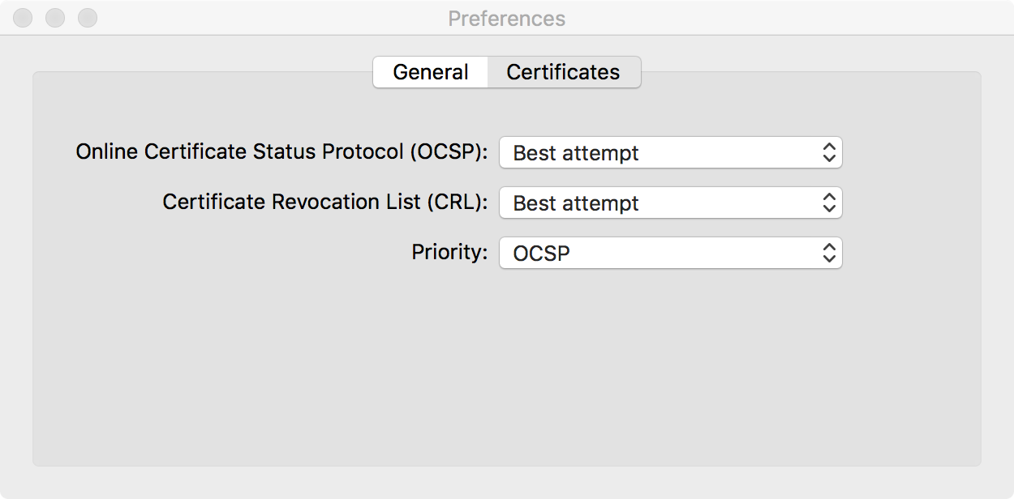
Authentication Methods
PKINIT – Configuration
Extra plist configuration goodness!
Keychain Access app has certificate security settings

Slide 36
Authentication Methods
PKINIT – Configuration
Extra plist configuration goodness!
a
A
CRLStyle - None | BestAttempt | RequireIfPresent
OCSPStyle - None | BestAttempt | RequireIfPresent
RevocationFirst - OCSP | CRL | Require Both
CRLSufficientPerCert - 0 | 1
OCSPSufficientPerCert - 0 | 1
defaults write ~/Library/Preferences/com.apple.security.revocation
Notes:
RevocationFirst – OCSP + other settings set to 1
- CRL + other settings set to 1
- Require Both – OCSP + other settings set to 0
This is part of my CIS repo

Slide 37
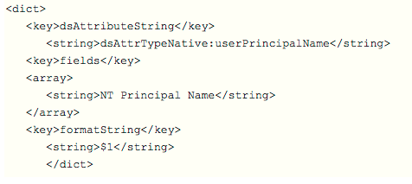
Authentication Methods
PKINIT – Legacy Configuration 10.6.3 – 10.12.x
/etc/cacloginconfig.plist
This same file is also used for “Attribute Matching”.
Notes:
That’s the entire plist file! It’s not even formatted properly!
This is currently configured for local account Attribute Matching as mentioned earlier.
Can be configured to refer to Active Directory.
Confusing huh?

Slide 38
Authentication Methods
PKINIT – Configuration 10.12 onwards
3rd Party Authorisation Plugins
US National Institutes of Health has one in development
It’s meant for PIV cards
Will go Open Source soon!
Regardless, you still need the previous slides info!

Slide 39
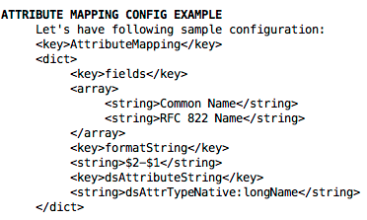
Authentication Methods
PKINIT – Configuration 10.12 onwards for CTK API
/etc/SmartcardConfig.plist
Notes:
Apple has changed the name of this file at least once, so be wary.
Also used for Attribute Matching for local accounts.

Slide 40
Authentication Methods
PKINIT – Configuration 10.12 onwards for CTK API
Extra plist configuration goodness!
a
A
a
This enforces PKINIT authentication
It disables the automatic pair prompt you would otherwise get.
defaults write /Library/Preferences/com.apple.security.smartcard UserPairing –bool NO

Slide 41
Authentication Methods
PKINIT – Configuration 10.12 onwards for CTK API
Extra plist configuration goodness!
a
A
a
By default certificates do not need to be trusted to allow association.
This setting globally enforces certificate trust.
defaults write /Library/Preferences/com.apple.security.smartcard checkCertificateTrust -bool YES

Slide 42
Authentication Methods
PKINIT – Configuration 10.12 onwards
Extra plist configuration goodness!
a
A
a
Allows you to disable particular format card access
Replace pivtoken with card format(s) of your choice
defaults write /Library/Preferences/com.apple.security.smartcard DisabledTokens –array com.apple.CryptoTokenKit.pivtoken

Slide 43
Authentication Methods
PKINIT – Configuration 10.12 onwards
Keep an eye on the manual page for “SmartCardServices”.
If there’s any documentation change, it’ll be there.
Legacy man page for “SmartCardServices-legacy”.
Not sure how long this will continue to work.

Slide 44
Authentication Methods
PAM Extensions – for Unix geniuses
Pluggable Authentication Module for SmartCards on 10.12+
Is an “authentication function class”. Ties into CTK API.
I’ll bet Centrify will use it ;)
man pam_smartcard
man pam_smartcard
Notes:
Ludovico Rousseau has a post on it: https://ludovicrousseau.blogspot.ch/2016/12/macos-sierra-and-pamsmartcard.html

Slide 45
Authentication Methods
PKINIT – The FileVault 2 Problem
A pure certificate authentication system will NOT work with FV2
The pre-boot authentication does not support 3rd party drivers
No username/password available on a PKINIT based account
Thus no smart card auth is possible ... at this point

Slide 46
Authentication Methods
PKINIT – The FileVault 2 Problem
A pure certificate authentication system will NOT work with FV2
The pre-boot authentication does not support 3rd party drivers
No username/password available on a PKINIT based account
Thus no smart card auth is possible ... at this point
Yikes!

Slide 47
Authentication Methods
PKINIT – The FileVault 2 Problem
I may have a workaround.
Inspired by some work by Allen Golbig and Rich Trouton
https://derflounder.wordpress.com/2012/02/22/hiding-an-filevault-2-enabled-admin-user-with-casper/

Slide 48
Authentication Methods
PKINIT – The FileVault 2 Problem
Script to gather information from a first login
Also asks user for a password to use
Creates a similarly named user to the card login user with password
Stops new account from being able to logon normally
FileVault 2 still allows it to login
Disable FV2 automatic login from earlier …
Find my proof of concept code here: http://www.github.com/franton/Create-FV2-Only-User
Find my blog post on this here: http://www.richard-purves.com/2016/11/05/fv2-and-smart-cards/

Slide 49
Authentication Methods
PKINIT – The Hybrid Method
Local account with a Kerberos ticket from a smart card?
Joel Rennich’s NOMAD project.
https://gitlab.com/Mactroll/NoMAD

Slide 50
Debugging
defaults write /Library/Preferences/com.apple.security.smartcard Logging -bool yes
All APDU traffic is then logged to “com.apple.security.smartcard.log”
If you disconnect the reader, it disables logging automatically.
https://ludovicorousseau.blogspot.com/2015/02/debug-smart-card-application-on-yosemite.html
defaults write /Library/Preferences/com.apple.security.smartcard Logging -bool yes
Notes:
Application Protocol Data Units

Slide 51
Final Thoughts
Delays in new OS support
Bugs present in OS – Card removal on Sierra doesn’t autolock screen!
3rd Party vendor driver delays – One supplier took four months!
CTK Attribute Matching code in Sierra doesn’t work with PAM plugin!
VM support issues
APDU packets don’t traverse the USB 3 emulation layer on VMWare Fusion
Use USB 2 instead. I’ve not tested other virtualisation software.
Security Issues?
Tampered smart card reader?
Implementation issues on the backend?
Notes:
VM issues – Joel mactroll Rennick found that one!
CTK attribute matching – curtesy of mac admins slack on the 27th January

Slide 52
Final Thoughts
The general Mac trend is away from Directory Services
PKINIT cert authentication = No more keychain password issues
WOOHOO!
I’m leaving a LOT out here.
Future APFS changes (it’s the end of encryption as we know it … but I feel fine!)
Apple has been changing/implementing features with every point release
Here’s the torch. Now its up to you!

Slide 53
Big Thanks!
Todd Thoule, Yoann Gini, Callum Dean, Daniel Hoit.
General assistance and advice
Robert Hammen
Info about auth plugins
Tom Bridge / Pepijn Bruienne
MacAdmins Podcast
Dan Brodjieski, Owen Pragel
macOS man pages and Configuration Profile info
#smartcard on Mac Admin Slack!

Slide 54
Big Links!
MacAdmin Podcast
http://podcast.macadmins.org/2016/10/11/episode-12-two-factors-enter/
Ludovic Rousseau
http://ludovicrousseau.blogspot.com
Random Oracle
https://randomoracle.wordpress.com/2015/01/16/smart-card-logon-for-os-x-part-i/
Me!
http://www.richard-purves.com/

Slide 55

Question + Answers

